Slide 1
Final Assessment
Excel Course

Slide 2
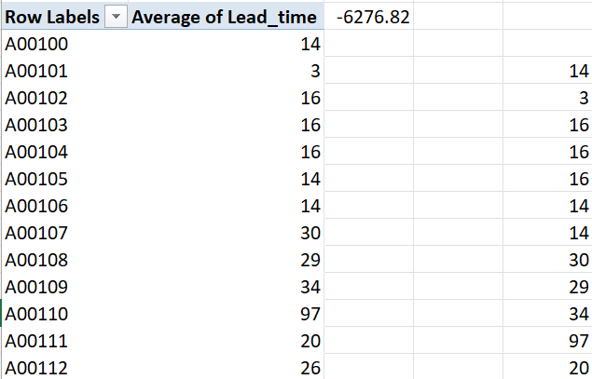
Question-1
Average of lead time is found to be -6276.82
After subtracting the “req date” and the “workdate”, found the average of that values using “=AVERAGE”.

Slide 3
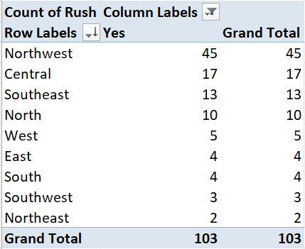
Question-2
Northwest District is found to be the district with highest number of rush jobs.

Slide 4
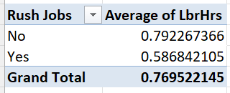
Question-3
Thus, from the image the average of labour hours for rush and non- rush jobs is found to be 0.769522145,with the following partition between “Yes” and “No”.

Slide 5
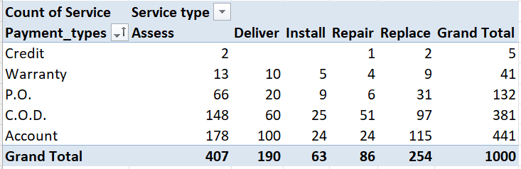
Question-4
Information on payment types for different services.

Slide 6
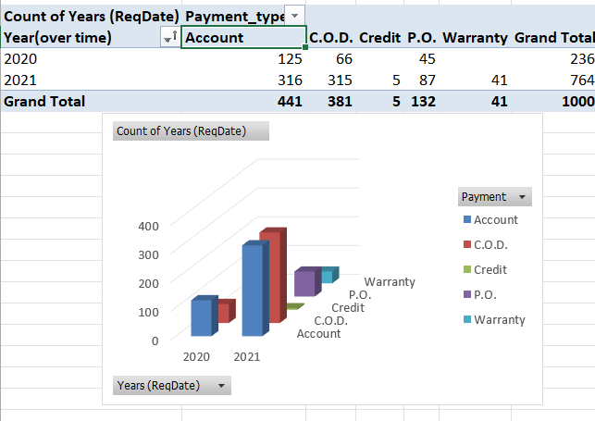
Question-5
So, from the graph it can be observed that
Over time(in terms of years) from 2020 to 2021
Warranty type is increased and for the others also
There is a bit improvement compared to 2020

Slide 7
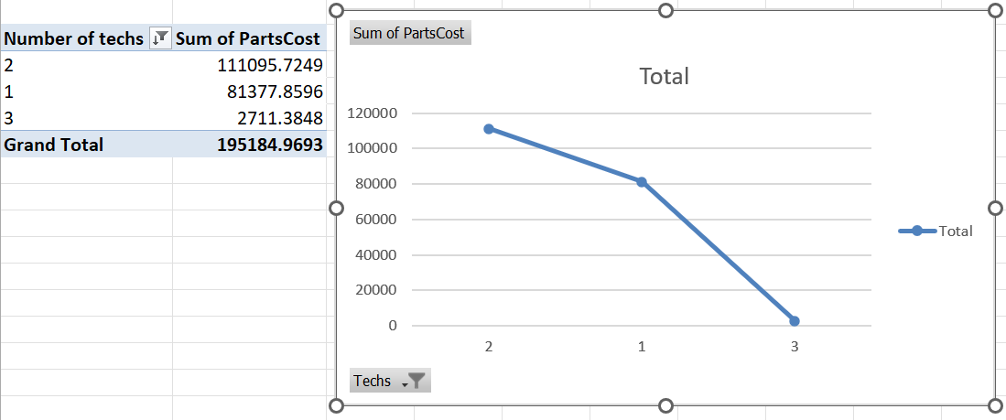
Question-6
There is no particular relation found between the number of technicians required and parts cost, as from the image below even if number of technicians is 2,parts cost seem to be high. A regular trend is not found.

Slide 8
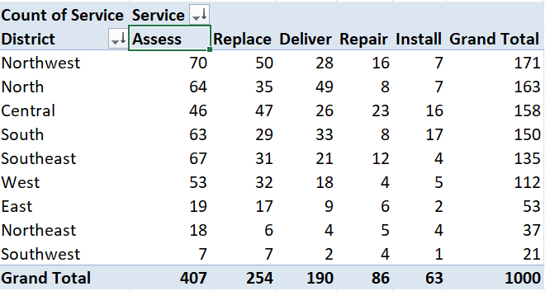
Question-7
Assess type service is the most common type service requested in “almost all” the districts where as in “Central” district replace service is found to be most common.

Slide 9
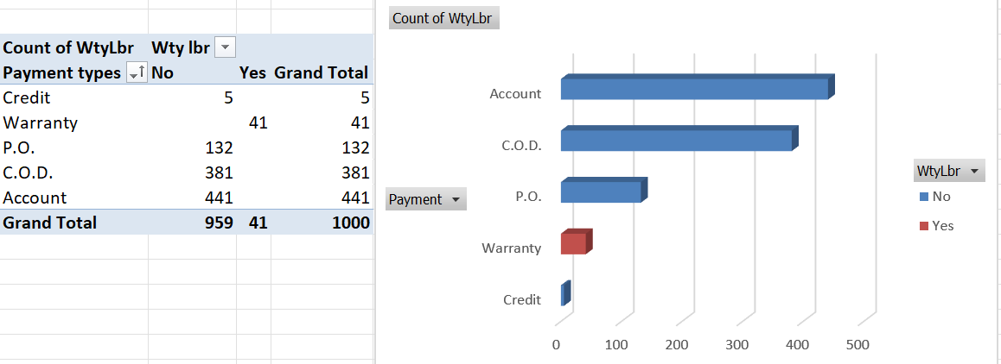
Question-8
Yes, in “Warranty” type , there seems to be low number of values compared to other payment types, from the image below.

Slide 10
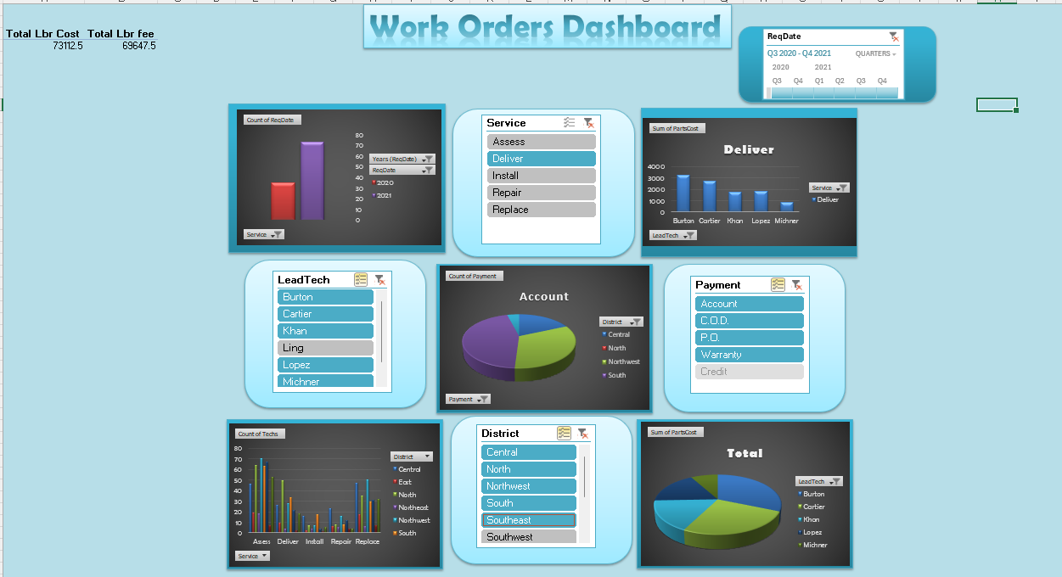
Question-9

